Slide 1

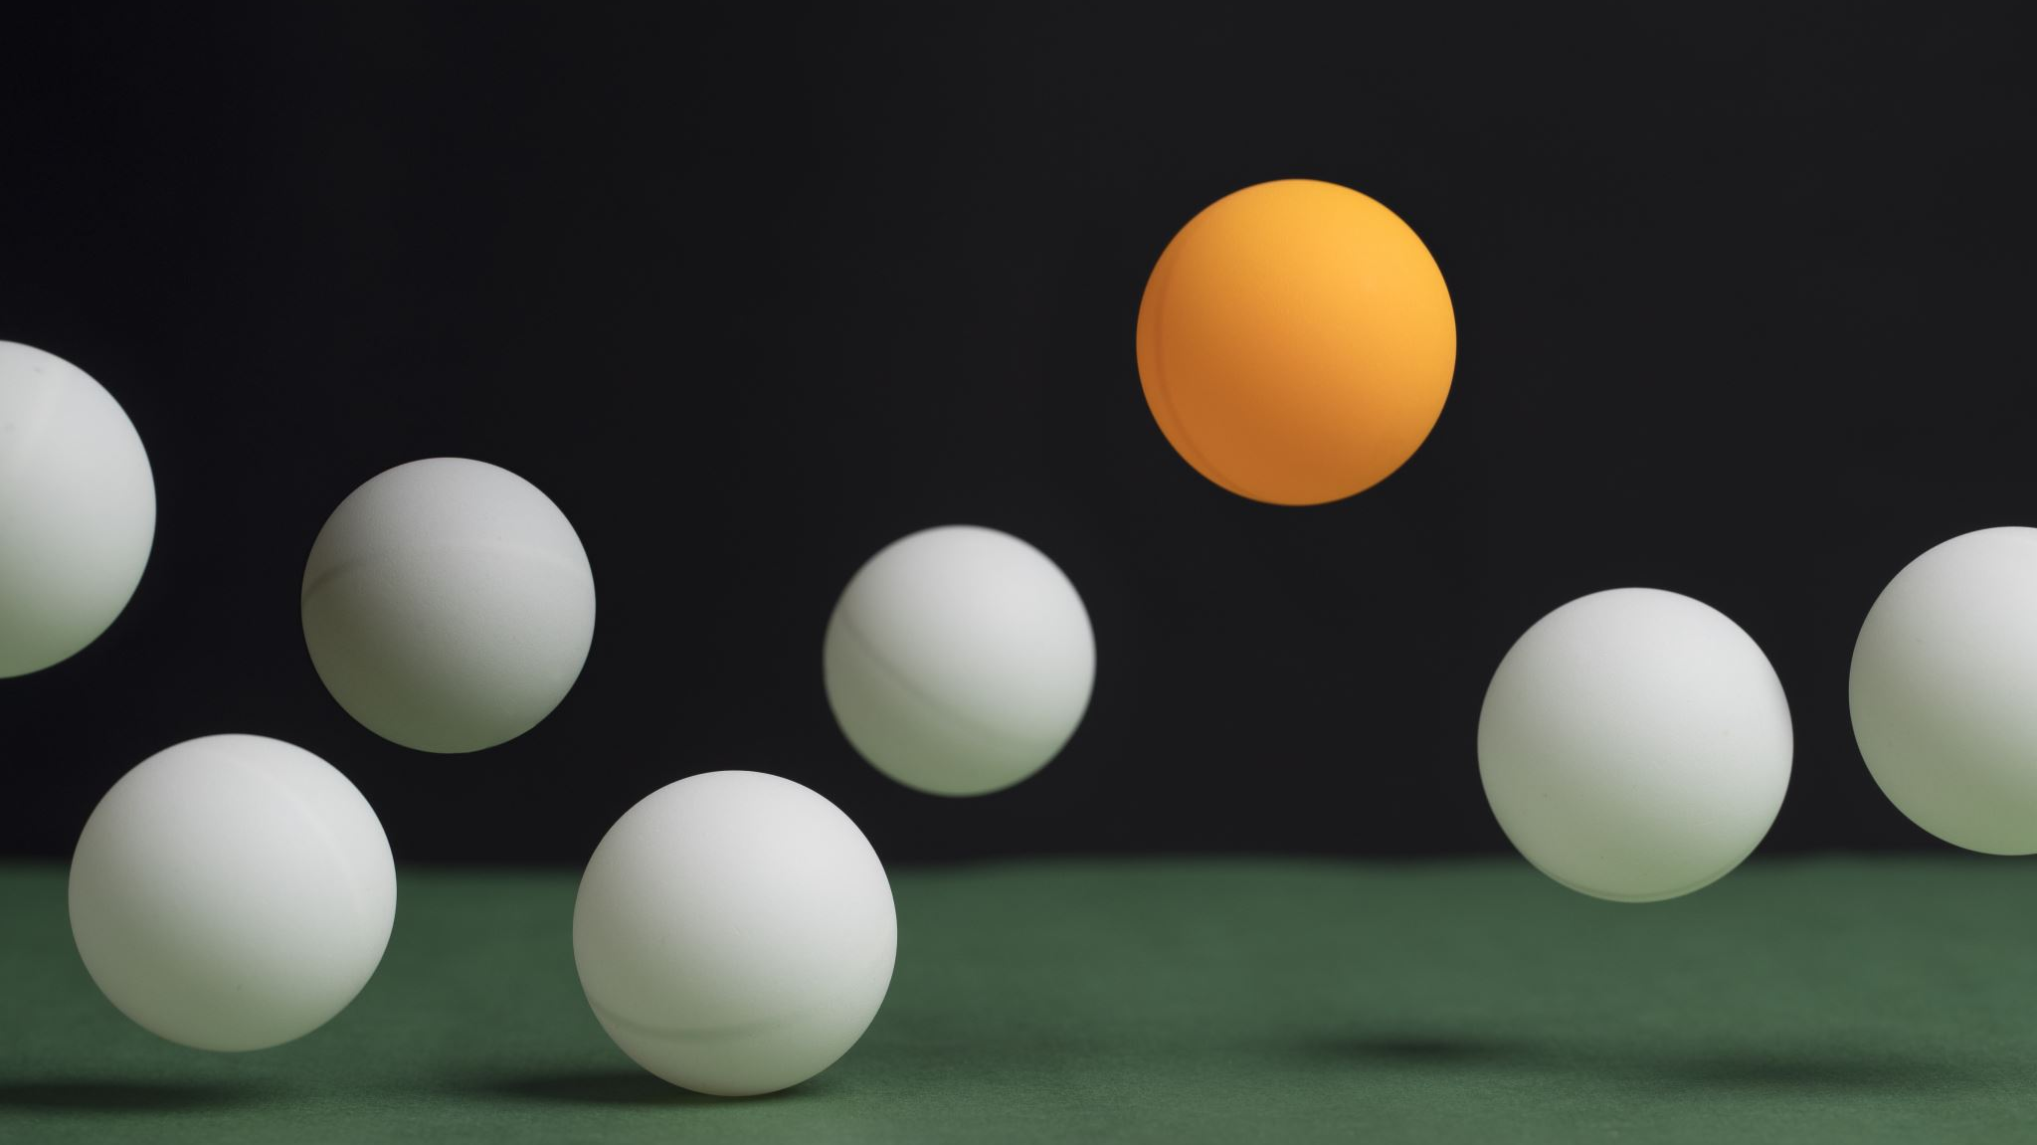
PING PONG
MCA 5TH SEM ANDROID PROJECT
ROMI AKHTAR KHAN (172120021)
YASH CHAUDHARY (172120075)

Slide 2
Objectives
Understand activities and linking with each other
Understand Object Oriented application design
Demonstrating usage of graphics, animations and sound
Understand usage of event handling and touch/multi touch
Utilization and working of screen orientation, boundaries and layout

Slide 3
Features
An interactive graphical ping pong game
Single player v/s computer
Computer automatically controlled with varying difficulty
2 players – both simultaneously controlled by touch
Automatically moving ball that collides with paddles and walls
Scoring system

Slide 4
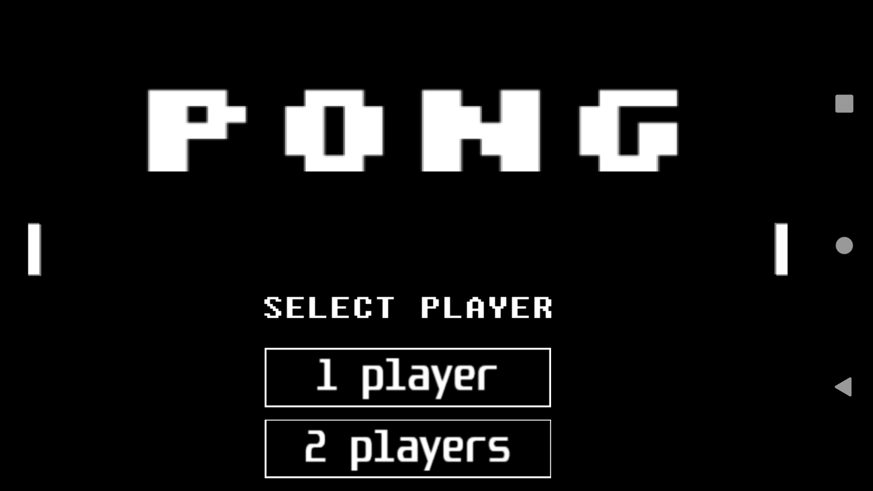
Main Activity

Slide 5
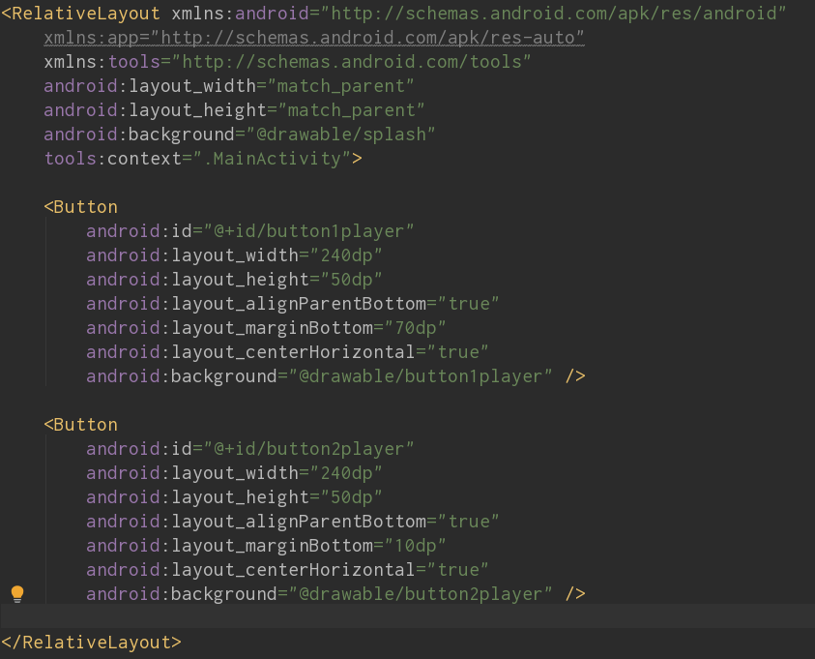
Layout Xml
Set the layout for main activity
Show a background image
Show two buttons with images for selecting single / 2 player

Slide 6
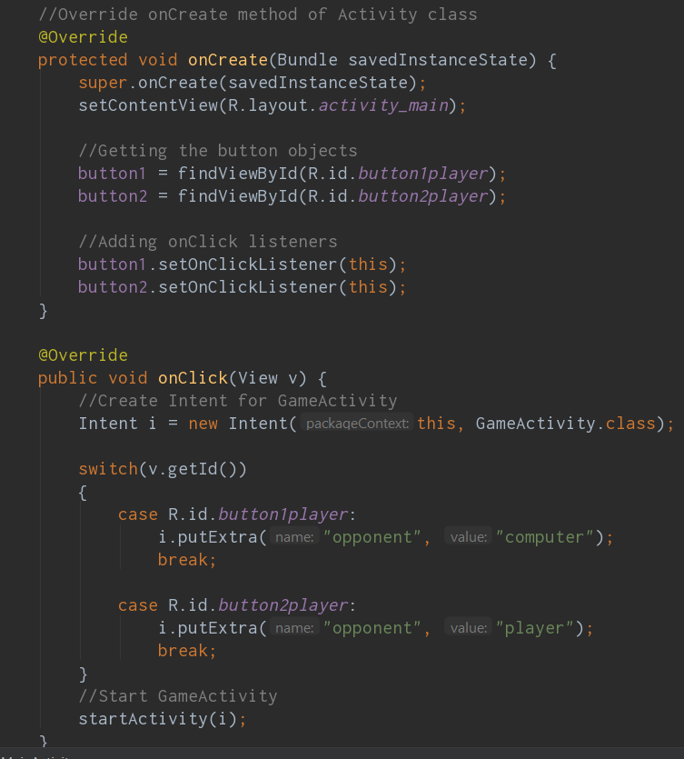
Set onClick action listener for each button
Start GameActivity and pass information about chosen opponent using Intent (Provides runtime binding of components such as Activities)

Slide 7
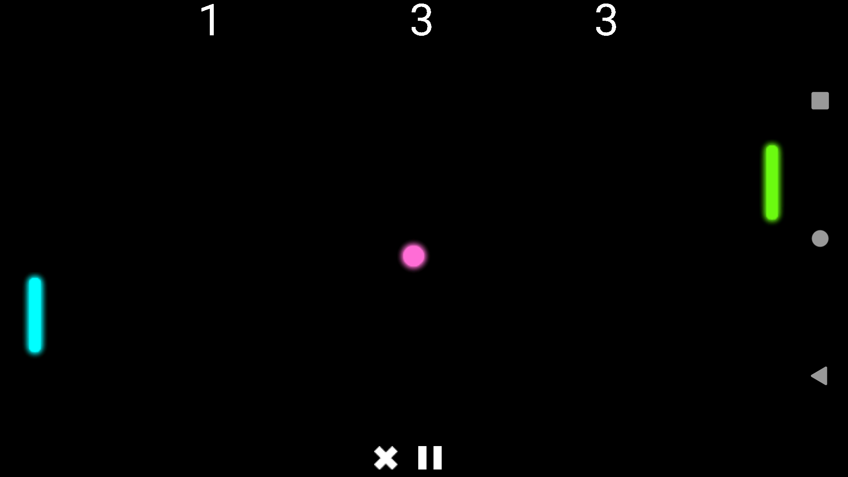
Game Activity

Slide 8
Player 1 Score
Player 2 Score
Timer
Player 2/Computer
Ball
Player 1
Quit
Pause

Slide 9
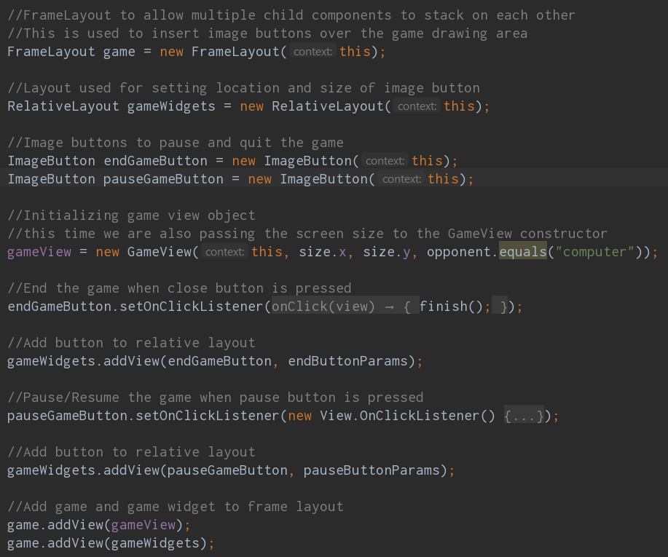
Game Activity main view
The game screen needs to show 2 things
Game objects (paddles, ball, score, timer)
Pause and Quit buttons
Game objects must be redrawn repeatedly but Buttons are persistent
A FrameLayout allows multiple items to be stacked on top of each other independently, so the game view and buttons are added to FrameLayout, which is then displayed on screen

Slide 10
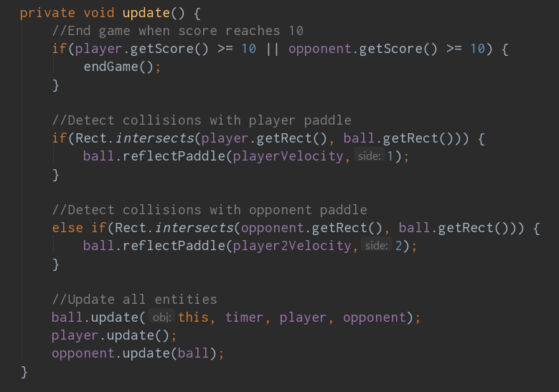
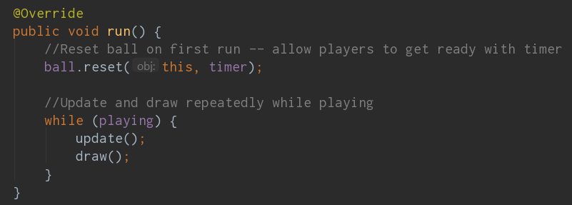
Game View Run Update loop
The game runs a continuous update draw loop until one side wins
All objects (ball, players, computer) are updated
Then updated positions are drawn
This repeated loop is used to produce animation

Slide 11
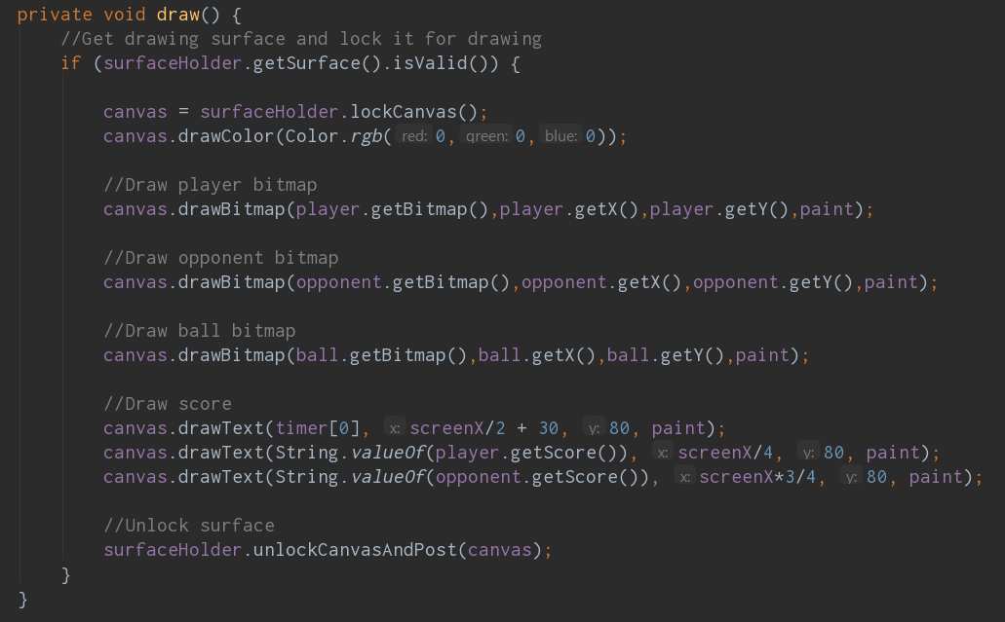
Draw objects after updating

Slide 12
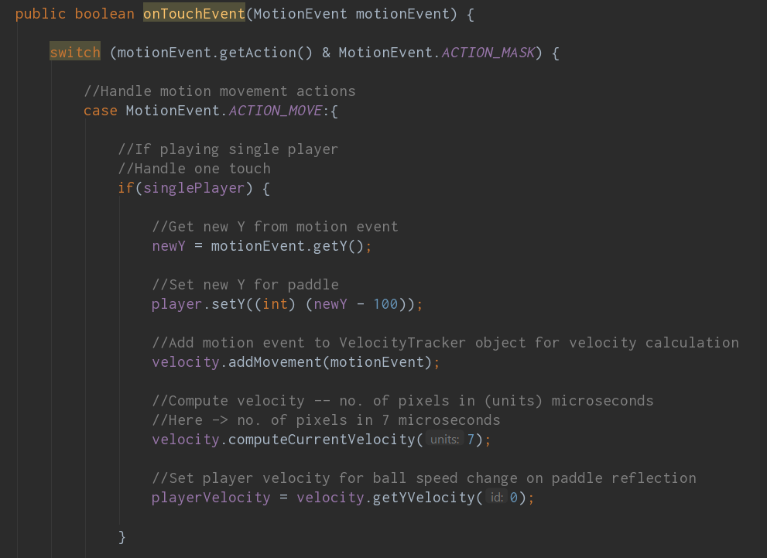
Handling Single Touch Events
In touch event handling, the player(s) paddles must move according to touch event
Velocity of touch motion is required to affect ball speed upon collision with paddle
(VelocityTracker is used)
When playing as 1 player, touch events move the left paddle
When playing 2 players, multiple touches are handled and corresponding player is updated
Each touch has a pointerID which prevents touch events from moving the wrong player

Slide 13
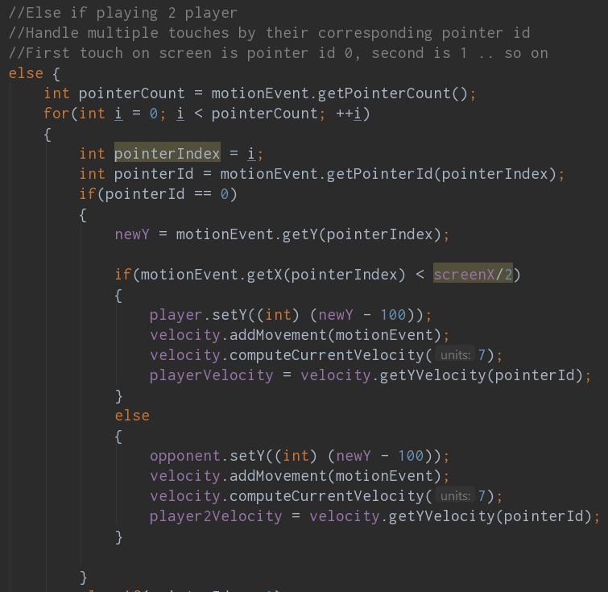
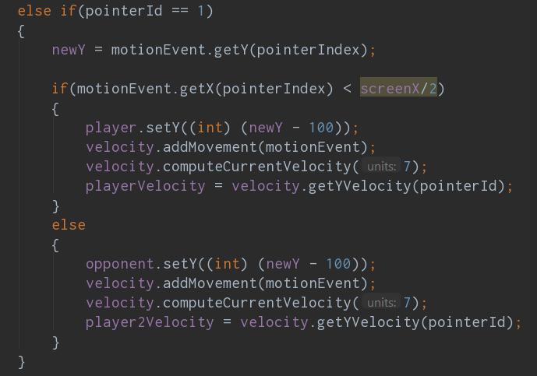
Multiple Touch events

Slide 14
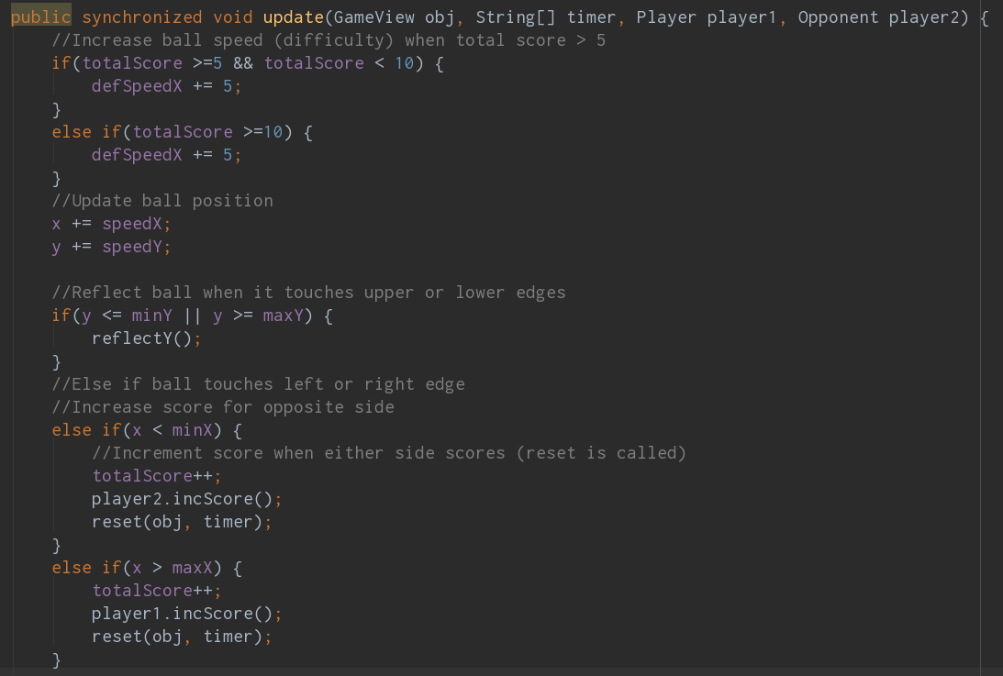
Ball update method
The ball has a constant speed in the x direction
The y direction speed can be changed with collision from a paddle
If ball touches upper or lower edges of screen, it gets reflected in opposite direction with the same speed
If ball goes past the left or right edge, the opposite side player scores
Ball speed is increased after total score reaches 5/10 (increased difficulty)

Slide 15
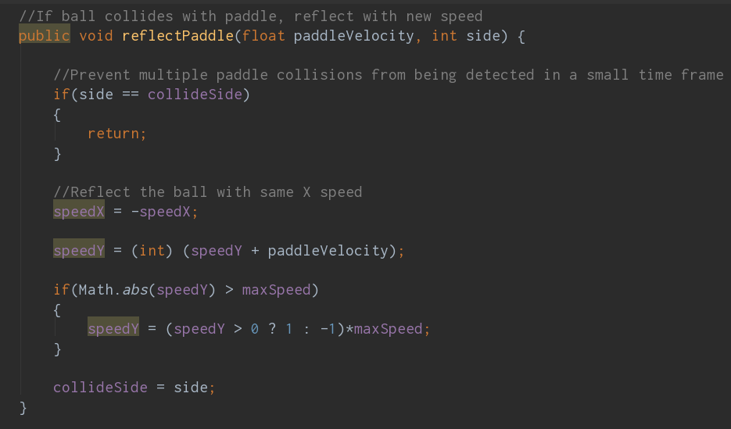
When ball collides with paddles, the speed is changed according to the paddle speed (calculated using Velocity Tracker)

Slide 16
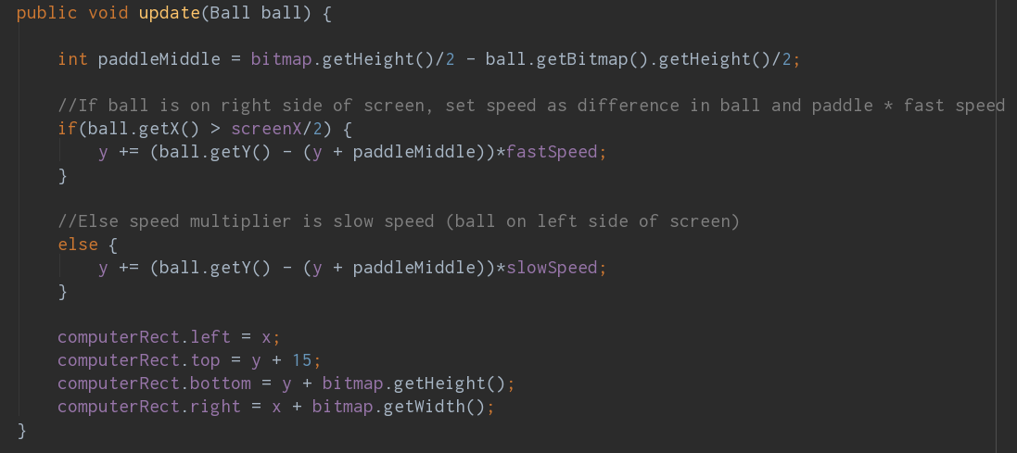
Computer update method
If playing single player, the computer opponent will move automatically
Distance between computer paddle and ball is measured
Computer paddle moves towards the ball with a speed of (distance) * speed factor
The speed factor varies depending on whether the ball is on the left or right side of the screen

Slide 18
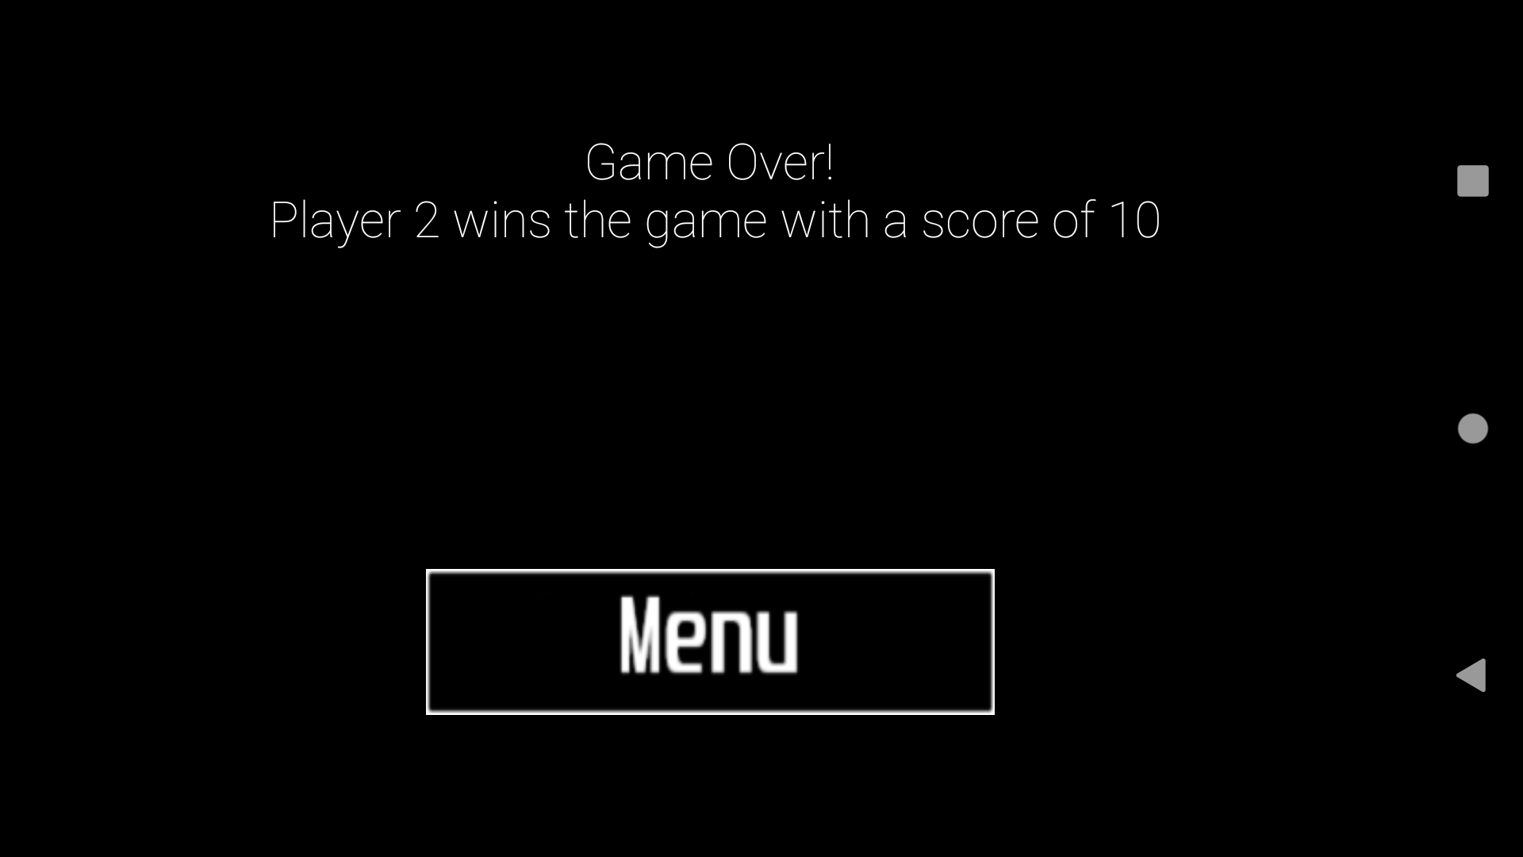
End Activity

Slide 19
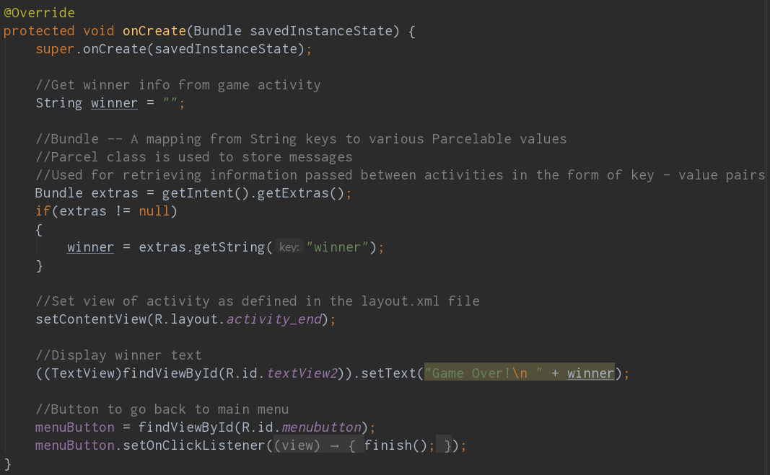
End Activity main view
End Activity is launched when game ends
The winner information is sent by Game Activity using Intent, this information is used to display the winner
A button is provided to go back to Main Menu

Slide 20
